Slide 1

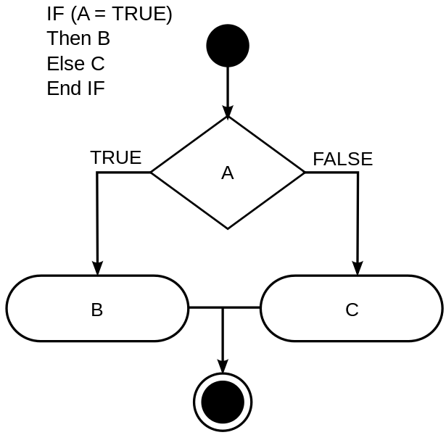
Module 2: Flow Control (if statements and loops)

Slide 2
Decisions
“There is no means of testing which decision is better, because there is no basis for comparison.”
Milan Kundera

Slide 3
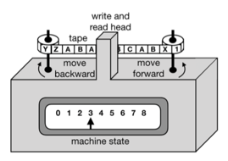
The ability to decide
Since the very beginning...
Conditional decisions were at the heart of the young Computer Science
From Machines to Universal Machines
Capability to adapt according to a programming
In all programming languages there is some form of decision command
Almost always an if command
All decisions are based on testing some sort of condition
Boolean algebra, True or False (kind of binary)
Turing Machine

Slide 4

if and if - else Commands
Basic decision command
Syntaxe:
if <condition-expression>:
<commands>
...
Write a program that receives three numbers (a, b, c) and discovers (prints out) which one among them is the largest one
if <condition-expression>:
<commands>
...
else:
<commands>
...
Solution in the next slide

Slide 5
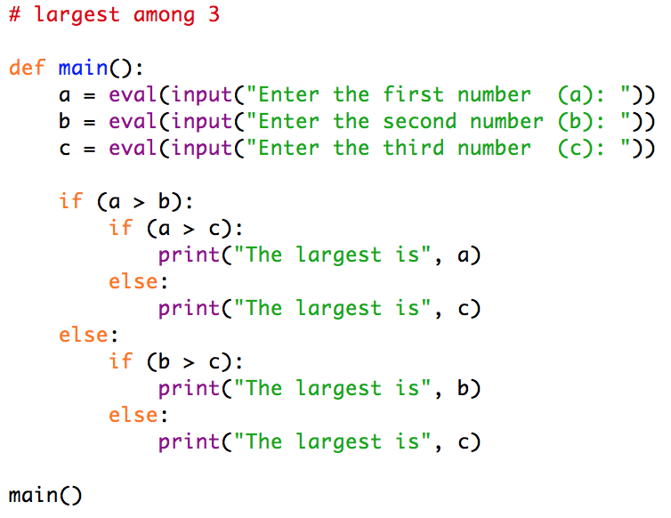
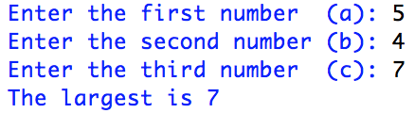
if and if - else Commands
The Largest One
Write a program that receives three numbers (a, b, c) and discover (prints out) which one among them is the largest one
Now, consider the input as a sequence of several numbers separated by commas
Solution in the next slide

Slide 6
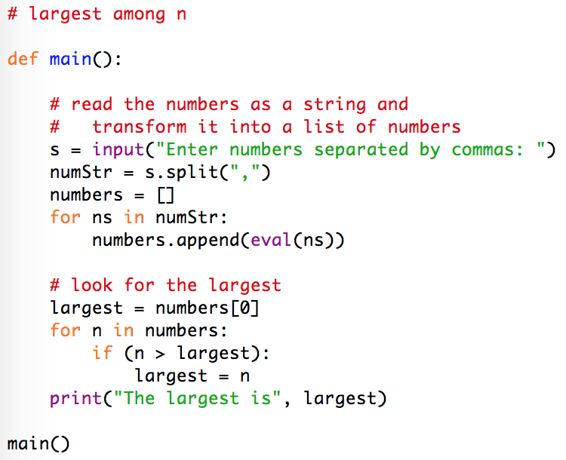
if and if - else Commands
The Largest One II
Write a program that receives a sequence of numbers separated by commas and discovers (prints out) which one among them is the largest one

Slide 7
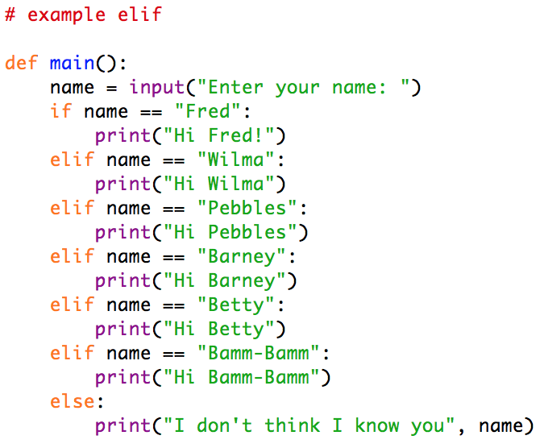
if - elif - else Command
Alternative conditions command
Syntax:
if <condition-expression>:
<commands>
...
elif <condition-expression>:
<commands>
...
...
else:
<commands>
...
Waterfall behavior: test one condition, then another, then ...

Slide 8
if - elif - else Command
Fahrenheit Classification
Write a program that receives a Fahrenheit temperature and prints how it feels according to this classification:
polar <= 0
freezing > 0 and <= 32
cold > 32 and <= 50
warm > 50 and <= 80
hot > 80 and <= 100
unbearable > 100
Solution in the next slide

Slide 9
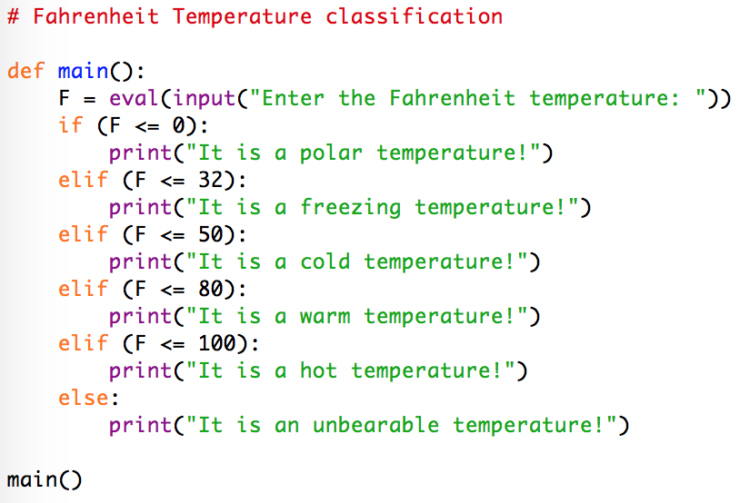




if - elif - else Command
Fahrenheit Classification Solution
polar <= 0
freezing > 0 and <= 32
cold > 32 and <= 50
warm > 50 and <= 80
hot > 80 and <= 100
unbearable > 100

Slide 10
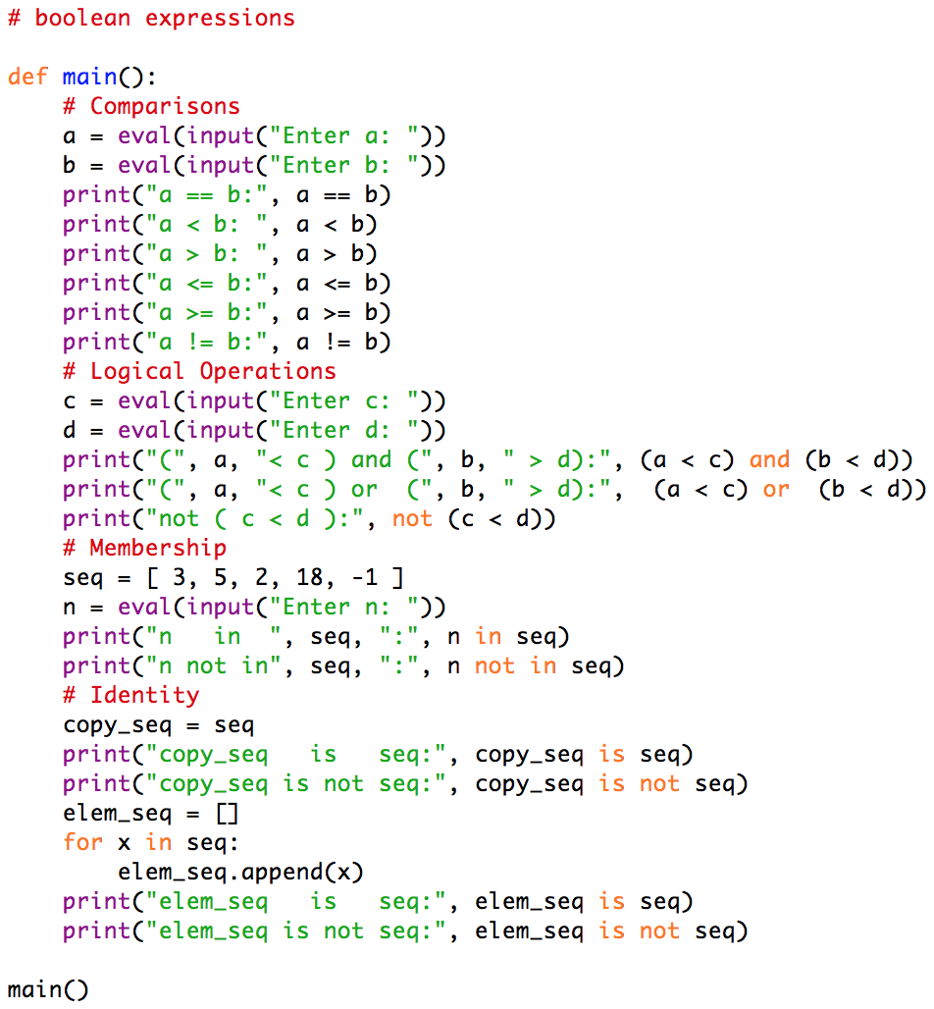
Condition Expressions
Booleans
True or False
Reserved words
Outcome of:
Comparisons
==, <, >, <=, >=, !=
Logical Operations
and, or, not
Membership
in, not in
Identity
is, is not

Slide 11
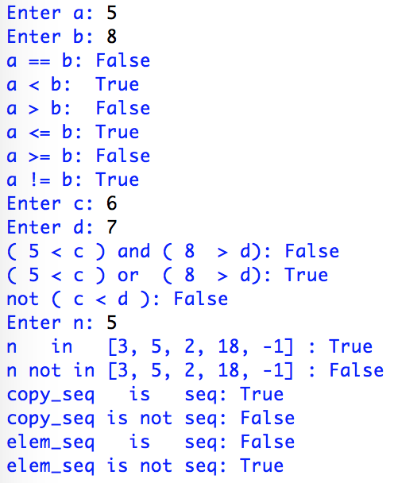
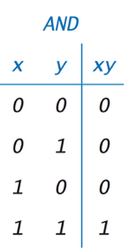
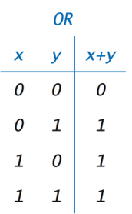
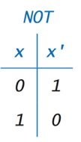
Condition Expressions
Run it yourself and analyse the output

Slide 12
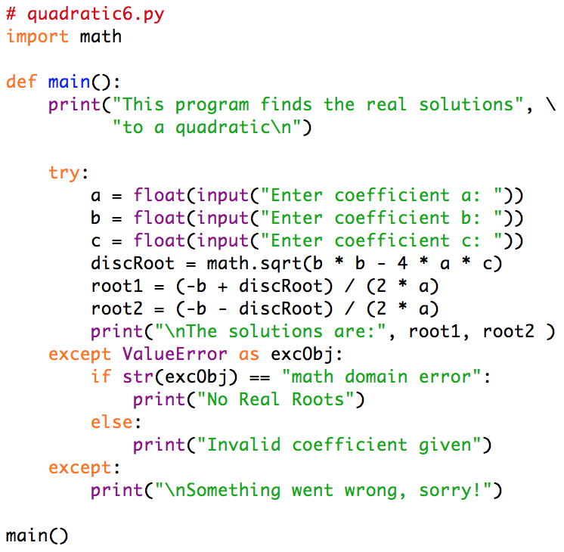
Exceptions Handling
Run it yourself!
A watchdog kind of decision
try:
<command>
…
except <kind> as <variable:
<command>
…
Common kinds:
ValueError
ArithmeticError
ZeroDivisionError

Slide 13
Lab Exercises
“You don’t have to see the whole staircase, just take the first step.”
Martin Luther King Jr.
Unevaluated, but totally worthy

Slide 14
Practical Exercise L1
Find the largest and the smallest
Write a program that finds the largest and the smallest values inside a given sequence entered by the user in a single string with numbers separated by commas.
Solution in the next slide

Slide 15
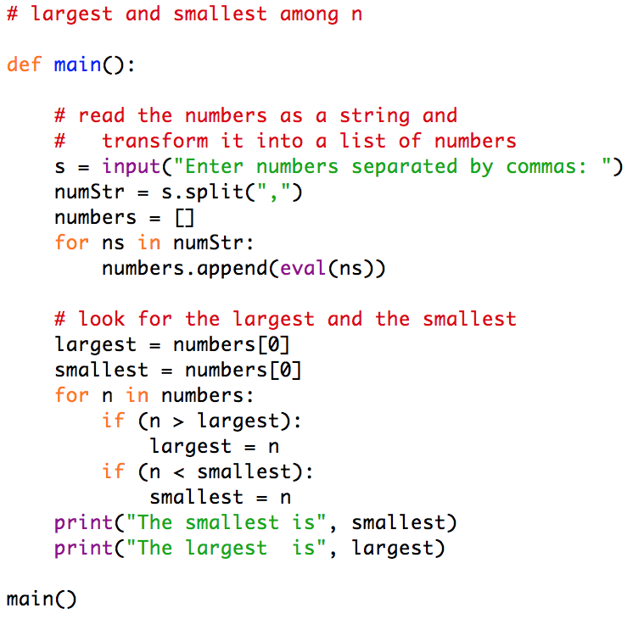
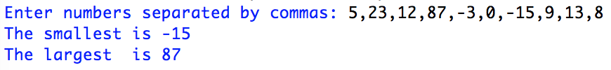
Practical Exercise L1
Find the largest and the smallest - Solution

Slide 16
Practical Exercise L2
What kind of triangle?
Write a program that verifies that three line segments identified by their sizes (a, b, c) can form a either:
Right Triangle - L² = s² + s²
Acute Triangle - L² < s² + s²
Obtuse Triangle - L² > s² + s²
Not a triangle - L > s + s
Equilateral Triangle - a = b = c
Isosceles Triangle - a = b ≠ c or a = c ≠ b or b = c ≠ a
Scalene Triangle - a ≠ b and a ≠ c and b ≠ c
Solution in the next slide

Slide 17
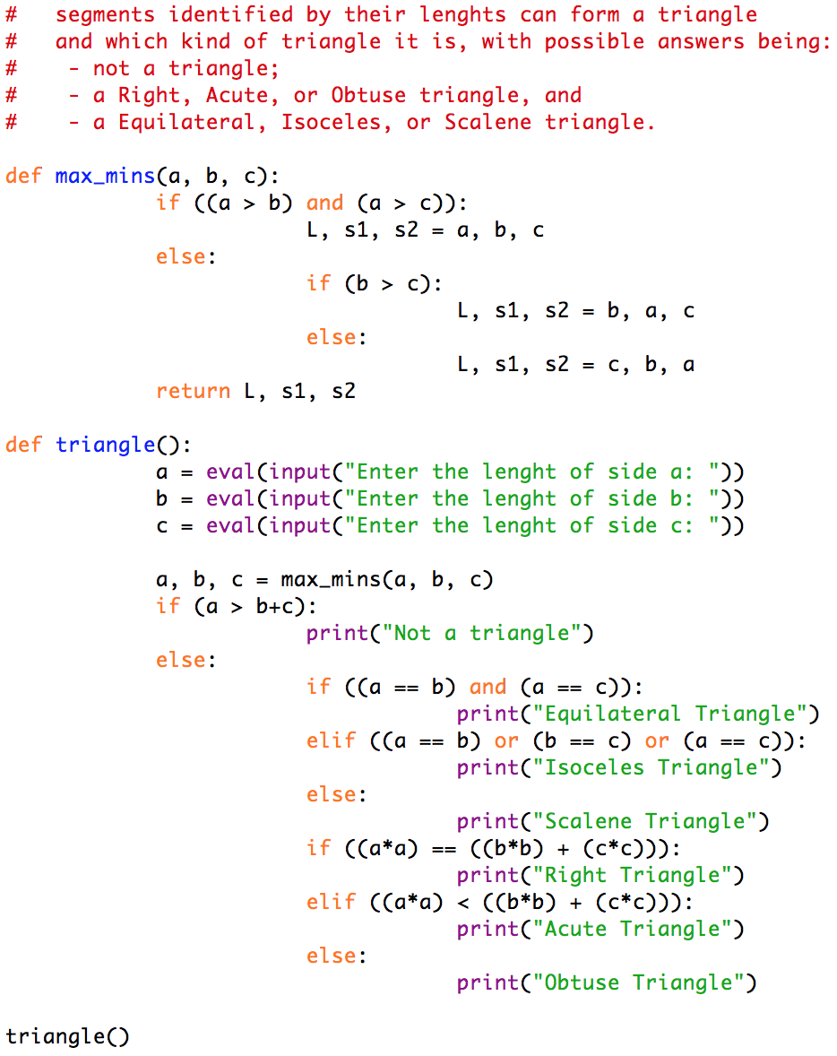
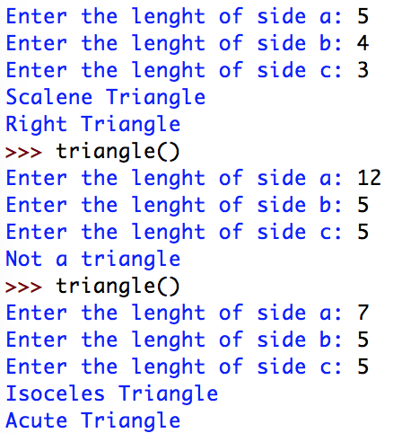
Practical Exercise L2
What kind of triangle? Solution

Slide 18
Practical Exercises L3 and L4
Exception in division
Write a program that computes the ratio between two integers
use exception handling to prevent division by zero
Exception in square root
Write a program that computes the square root of a number entered by the user
use exception handling to prevent a complex number
Solutions in the next slide

Slide 19
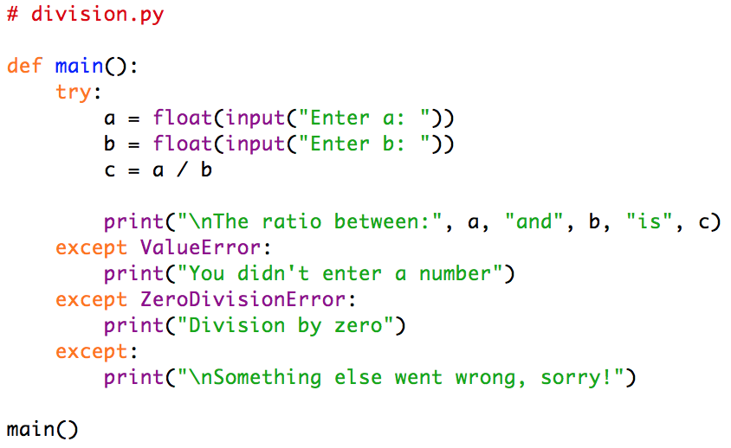
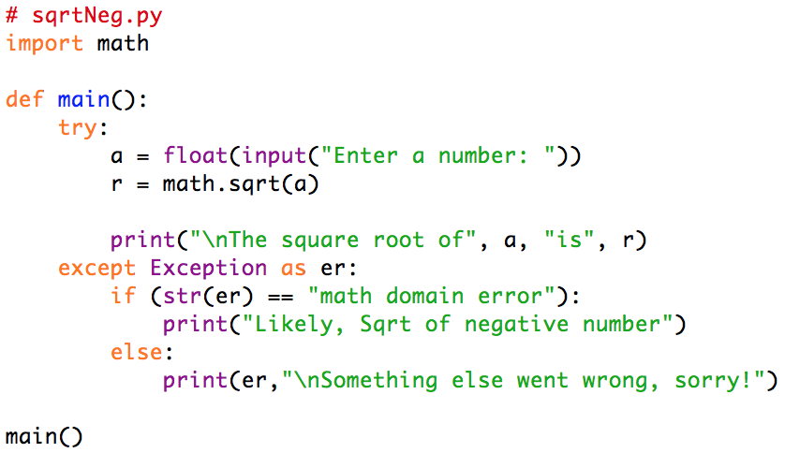
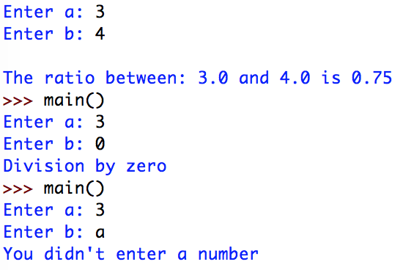
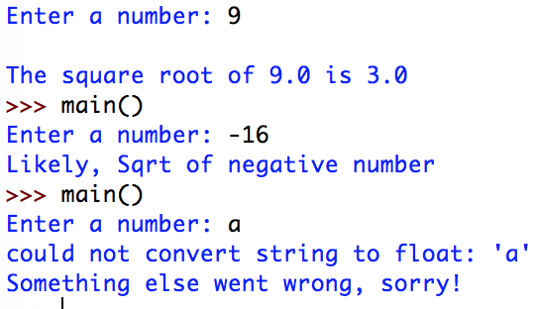
Practical Exercises L3 and L4
Exception in division Exception in square root

Slide 20
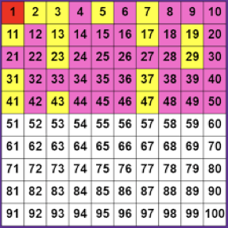
Practical Exercise L5
Identifying Prime Numbers
Write a program to ask the user a Natural number smaller than 100 and prints if it is a prime number or not
Solution per request
(likely available in the Internet)

Slide 21
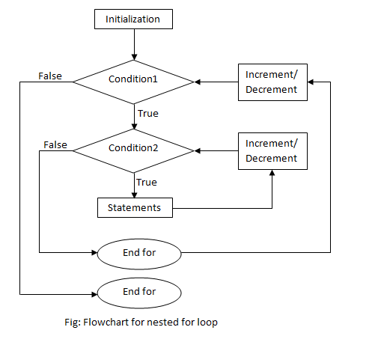
Loop Structures and Booleans

Slide 22
Loops
“History is about loops and continuums.”
Mike Bidlo

Slide 23

Do it again...
Loops
All machines are intended to perform repetitive activities, and Universal Machines are not different
The first large scale IBM computer was sold to US government to summarize the 1950 census before the 1960 census starts
Summarizing is to repeatedly perform the same operation to all input information
Loops and lists (sequences) are the perfect match for loops
In all programming languages there is some form of loop command
BASIC, Algol, C language, Java and most procedural programming languages have variations of for and while loops very similar to Python commands

Slide 24




The for loop
Definite Loop
Syntaxe:
for <variable> in <sequence>:
<commands>
...
The <variable> will be of the same type as the elements of the <sequence>
The sequence can be expressed as:
An explicit sequence
A sequence variable
A function returning a sequence
Usually: range(...)
Let’s talk about range()

Slide 25
The range(...) built-in function
Producing Sequences from Numerical Expressions
range(<expression stop>)
range(5) is equivalent to [0,1,2,3,4]
range(11) is equivalent to [0,1,2,3,4,5,6,7,8,9,10]
range(<expression start>,<expression stop>)
range(1,11) is equivalent to [1,2,3,4,5,6,7,8,9,10]
range(5,15) is equivalent to [5,6,7,8,9,10,11,12,13,14]
range(-2,4) is equivalent to [-2,-1,0,1,2,3]
range(<expression start>,<expression stop>,<expression step>)
range(1,10,2) is equivalent to [1,3,5,7,9]
range(1,11,2) is equivalent to [1,3,5,7,9]
range(9,-1,-1) is equivalent to [9,8,7,6,5,4,3,2,1,0]
range(15,3,-3) is equivalent to [15,12,9,6]
0 to
before stop
+1
start to
before stop
+1
start to
before stop
+step

Slide 26
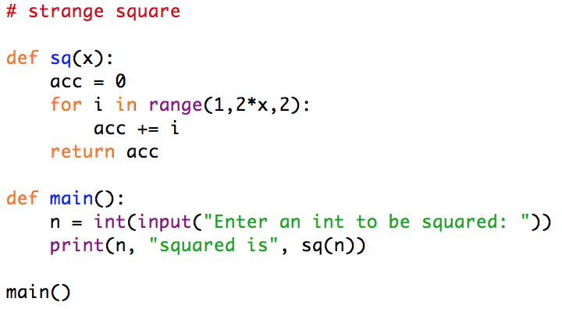
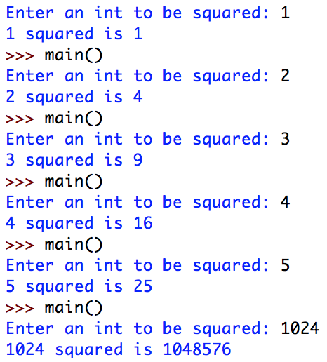
The for loop example
The Strange Square
Write a program that receives one number (n) and computes the square of this number by adding all first n odd Natural numbers
1² = 1
2² = 1 + 3
3² = 1 + 3 + 5
4² = 1 + 3 + 5 + 7
5² = 1 + 3 + 5 + 7 + 9

Slide 27
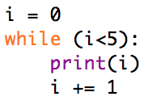

The while loop
Indefinite Loop
Syntaxe:
while <condition>:
<commands>
...
Execute the commands inside the block while <condition> is True or until <condition> turn out to be False
It may never execute if <condition> is False at the first time
It may run “forever” if <condition> starts as True and never changes to False
Let’s talk about Booleans again

Slide 28

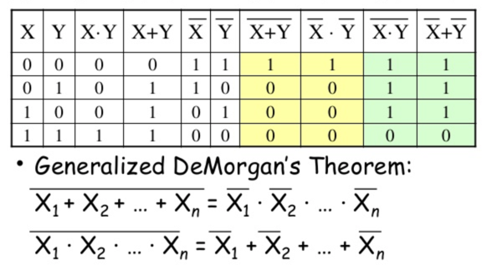
Booleans and Boolean Algebra
True (1) - False (0)
Logic operators over Booleans: X - Y
X and Y ⇔ X · Y
X or Y ⇔ X + Y
not X ⇔ X
Logic Notation
Important for while conditions, but also for if and elif

Slide 29
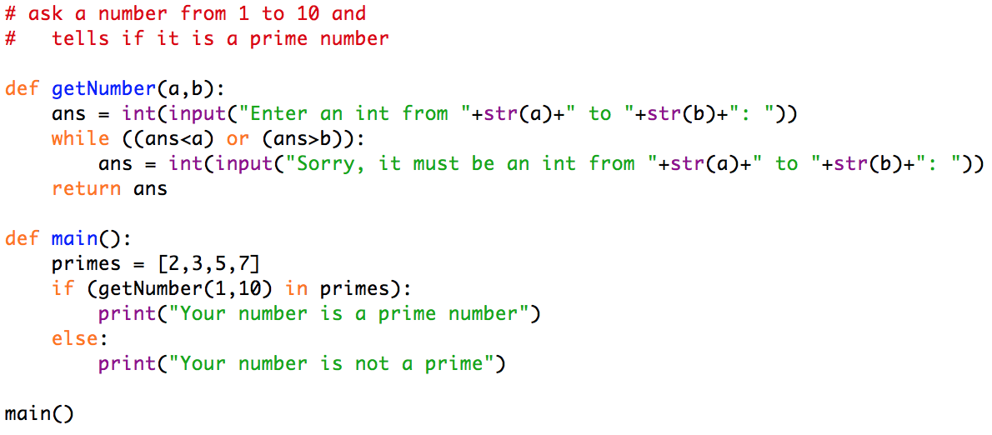
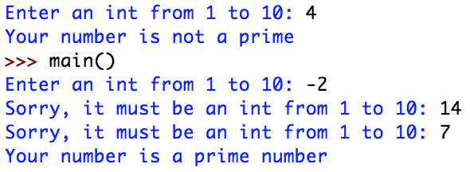
The while loop example
Restrict Input from 1 to 10
Write a program that asks the user a Integer number from 1 to 10 and then say if the user chosen number is a prime or not (Sentinel Loop)

Slide 30
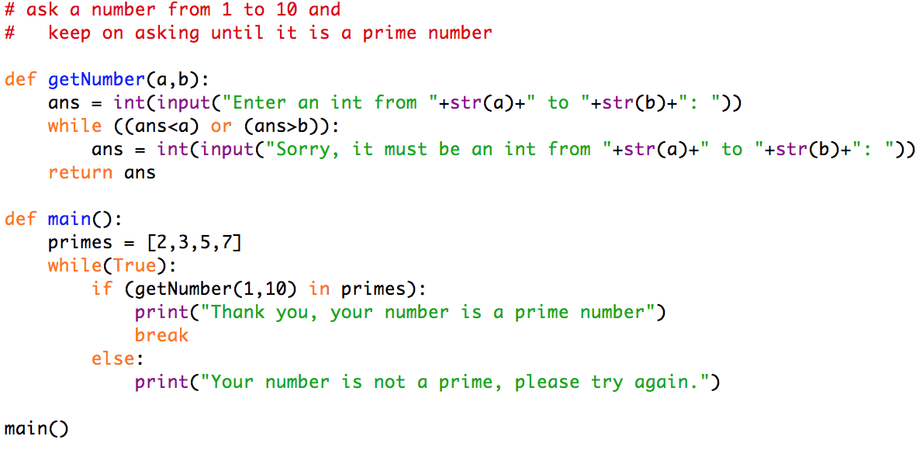
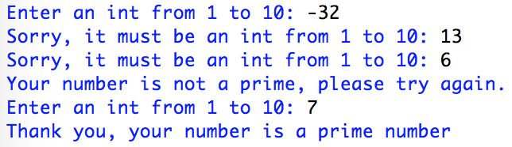
The break command
Stopping a Loop
Syntaxe:
break
Usually employed inside a loop:
if <condition>
...
break
...
It stops the loop execution, interrupting the current iteration

Slide 31
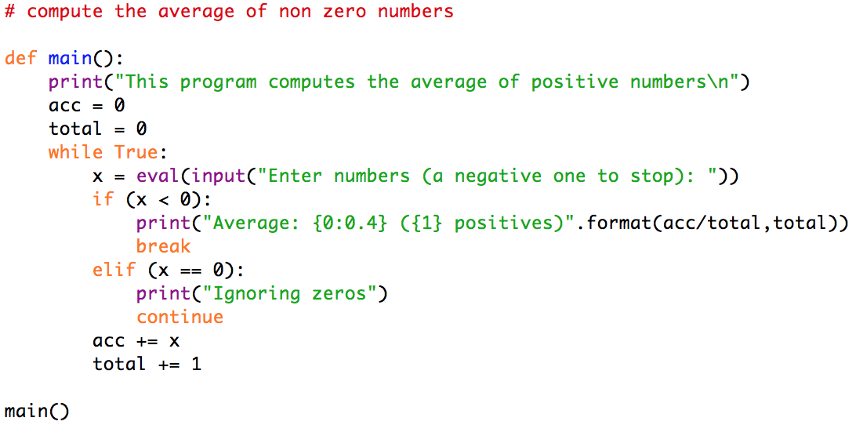
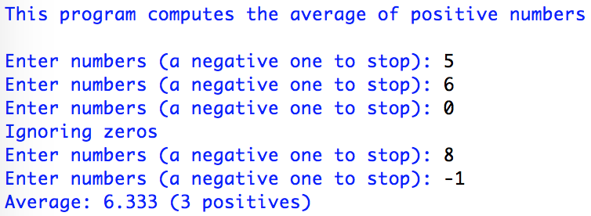
The continue command
Skipping an Iteration
Syntaxe:
continue
Usually employed inside a loop:
if <condition>
…
continue
...
It interrupts the current iteration, but the loop itself goes on

Slide 32
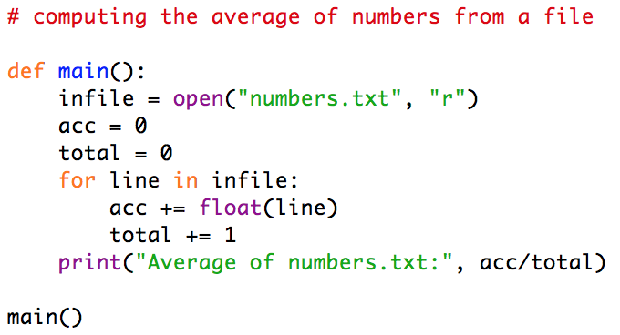
File Loop
Reading lines of a file
Syntaxe:
for <string variable> in <file variable>:
<commands>
...
It reads a line at a time
To run this example download the file numbers.txt from moodle page into the folder where your program is

Slide 33
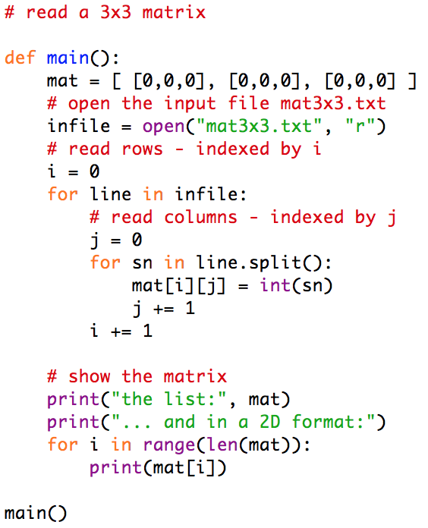
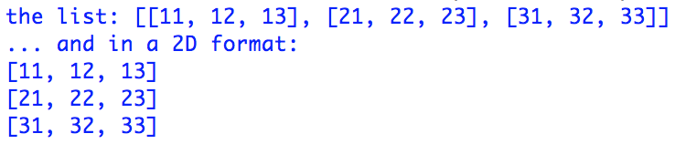
Nested Loops
Any kind of loops, one inside another
Read a 3x3 matrix from a file
Store it in two-dimensional list
Print it unidimensionally and bidimensionality
To run this example download the file mat3x3.txt

Slide 34
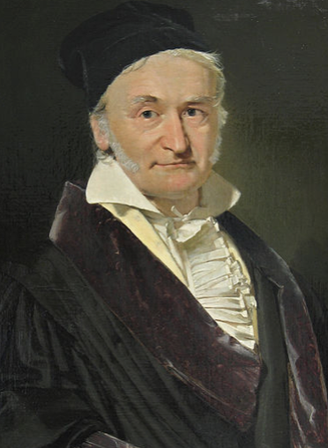
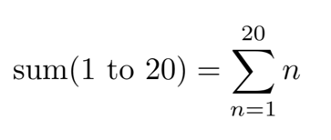
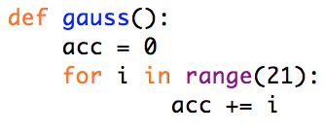
Accumulators
Usually employed with for loops
Accumulates data, specifically when adding
Keeping memory, in general
Adding Example
Initialize a variable
Repeat accumulating
Karl Friedrich Gauss
1777 - 1850 - 1855
range(n) => [0, 1, … n-2, n-1]
range(5) => [0,1,2,3,4]
range(21) => [0,1,...,19,20]
Source: https://en.wikipedia.org/wiki/Carl_Friedrich_Gauss

Slide 35
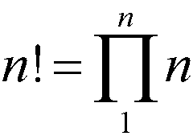
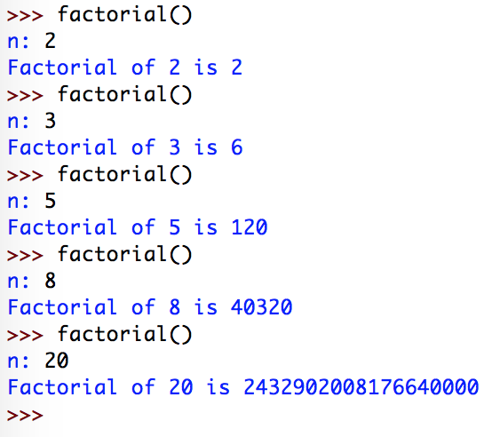
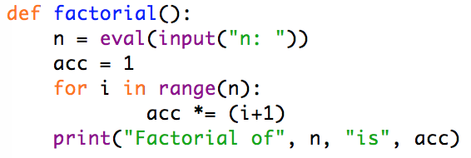
Accumulators
Factorial
Still an accumulation, with product instead of sum
Initialize a variable
Repeat accumulating (multiplying)

Slide 36
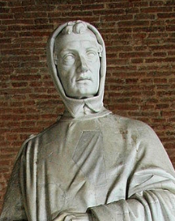
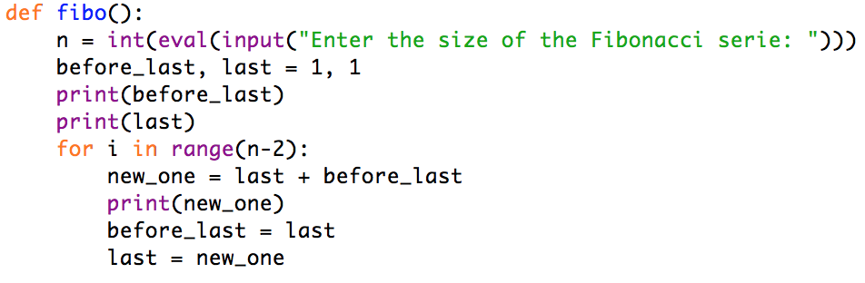
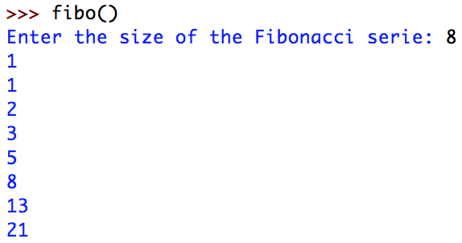
Accumulators
Fibonacci Sequence
Every number is computed based on the previous two
1, 1, 2, 3, 5, 8, 13, 21, 34, 55, 89, ...
Leonardo Fibonacci
1170 - 1250
Try for 20 numbers
6765

